Slide 1

WAP Project - Group 5
Thao Duc Vu
Yan Zhao

Slide 2
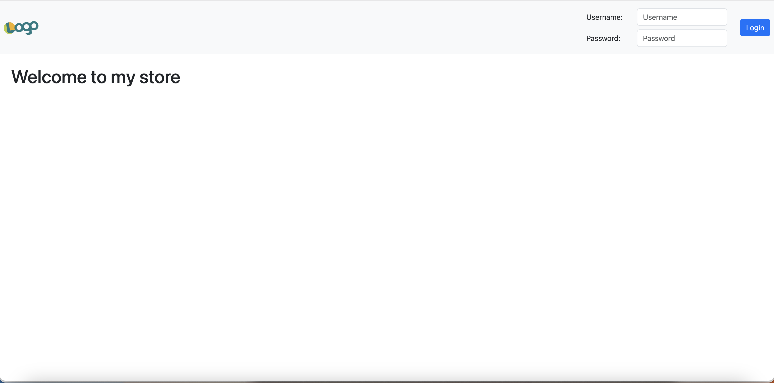
Home Screen

Slide 3
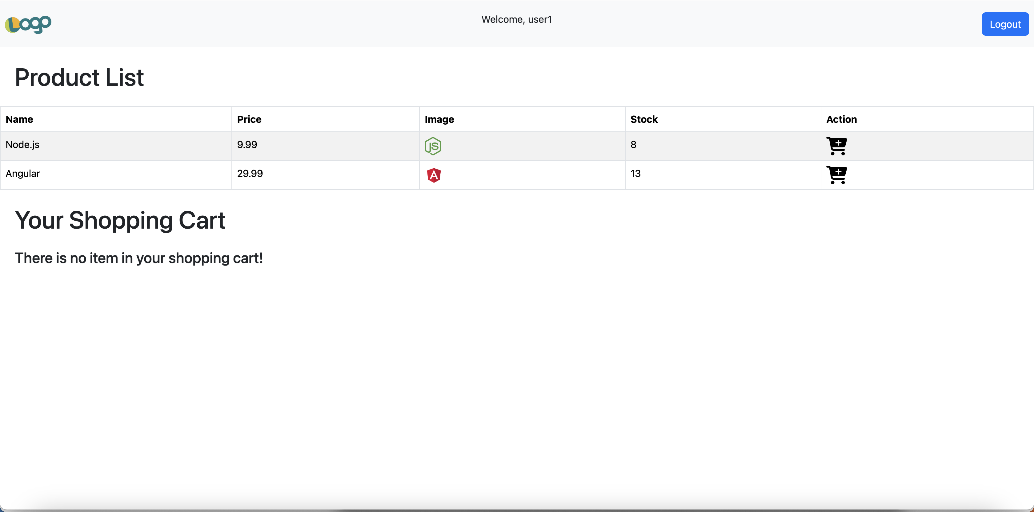
Shopping Screen

Slide 4
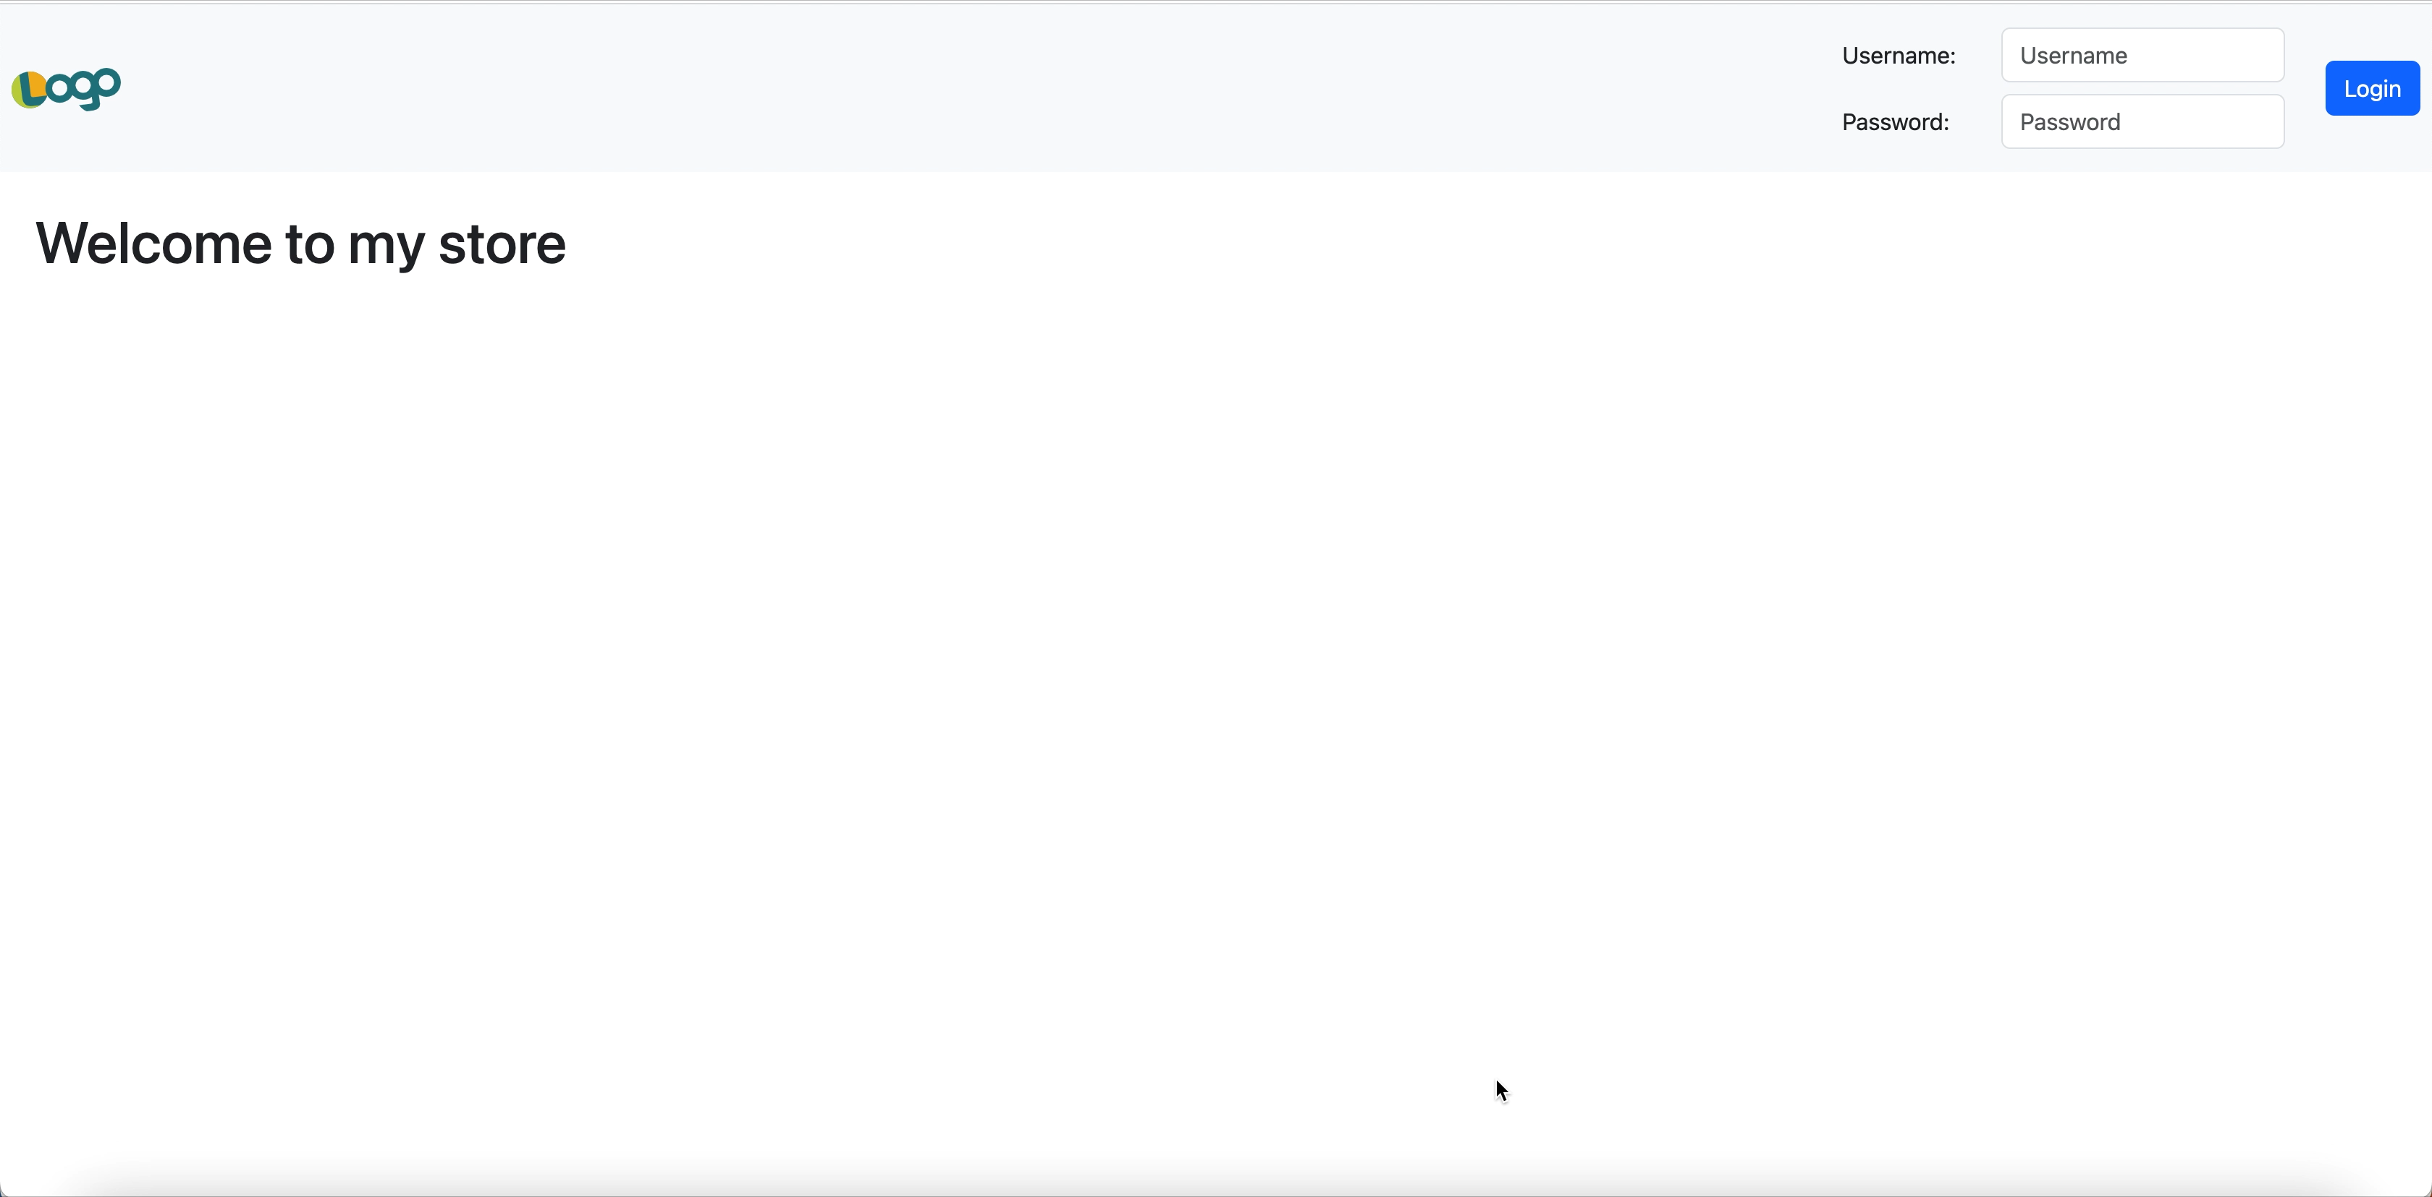
Login Function

Slide 5
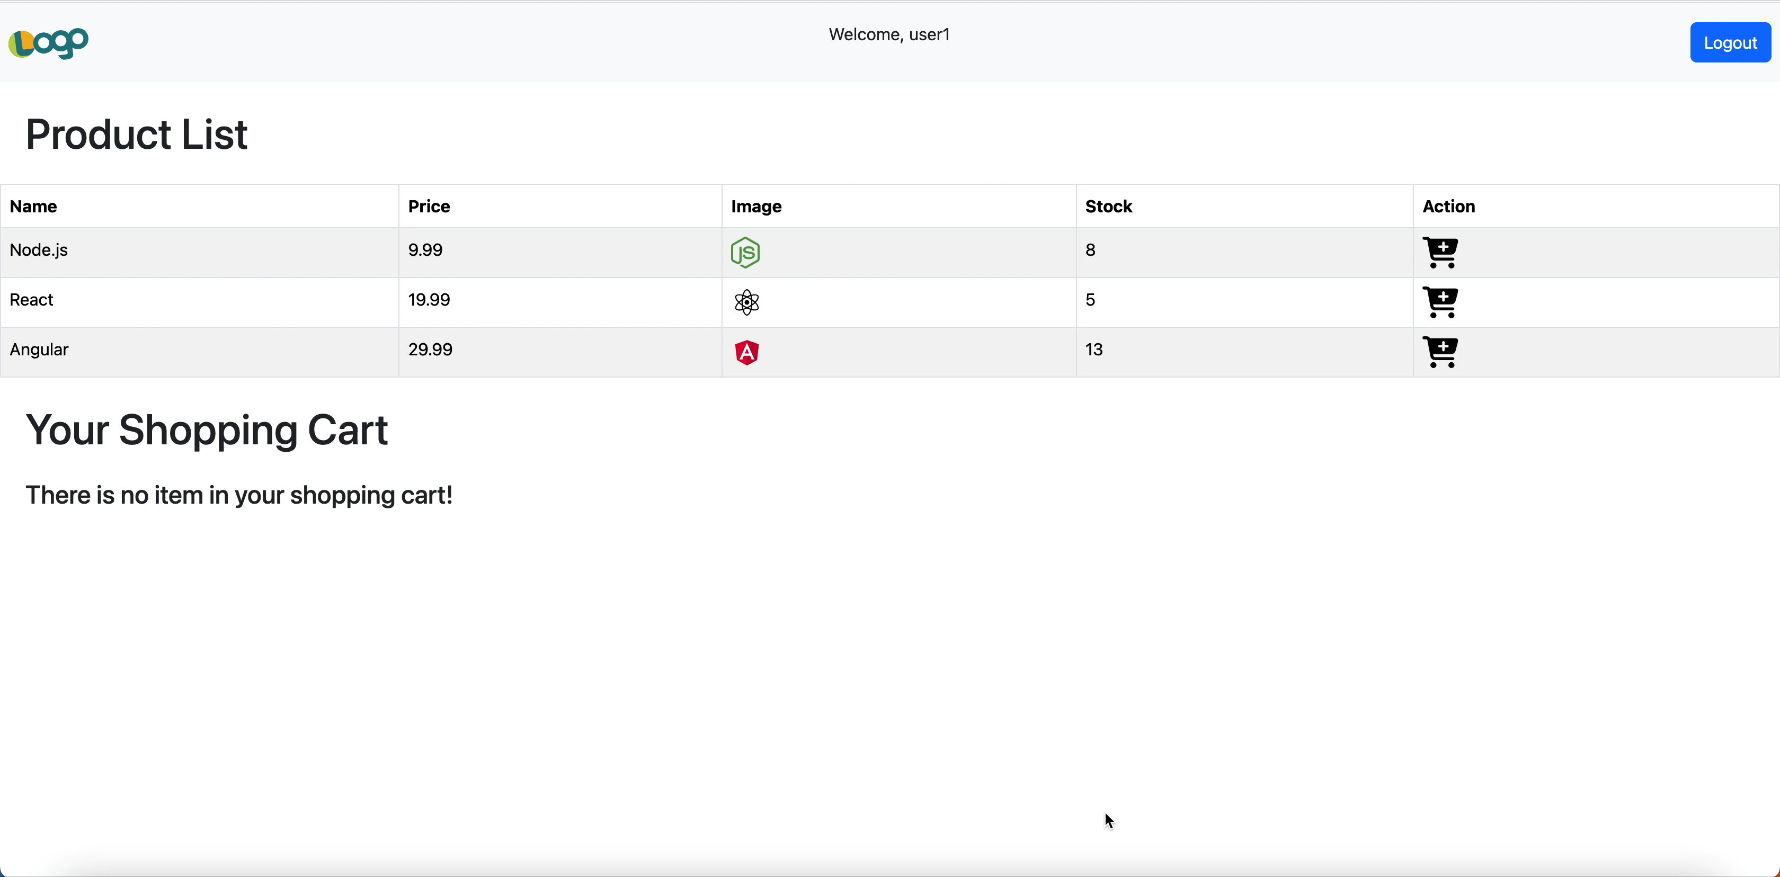
Logout Function

Slide 6

Add cart item from product list

Slide 7
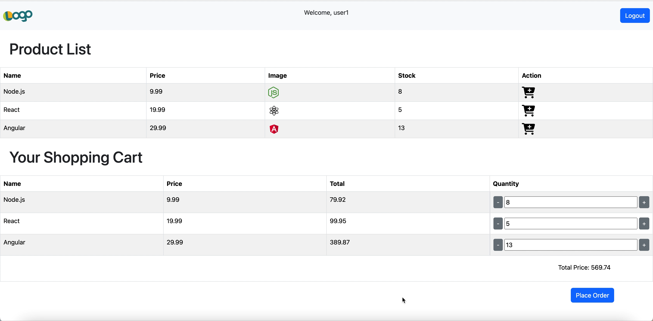
Add and remove item in cart

Slide 8
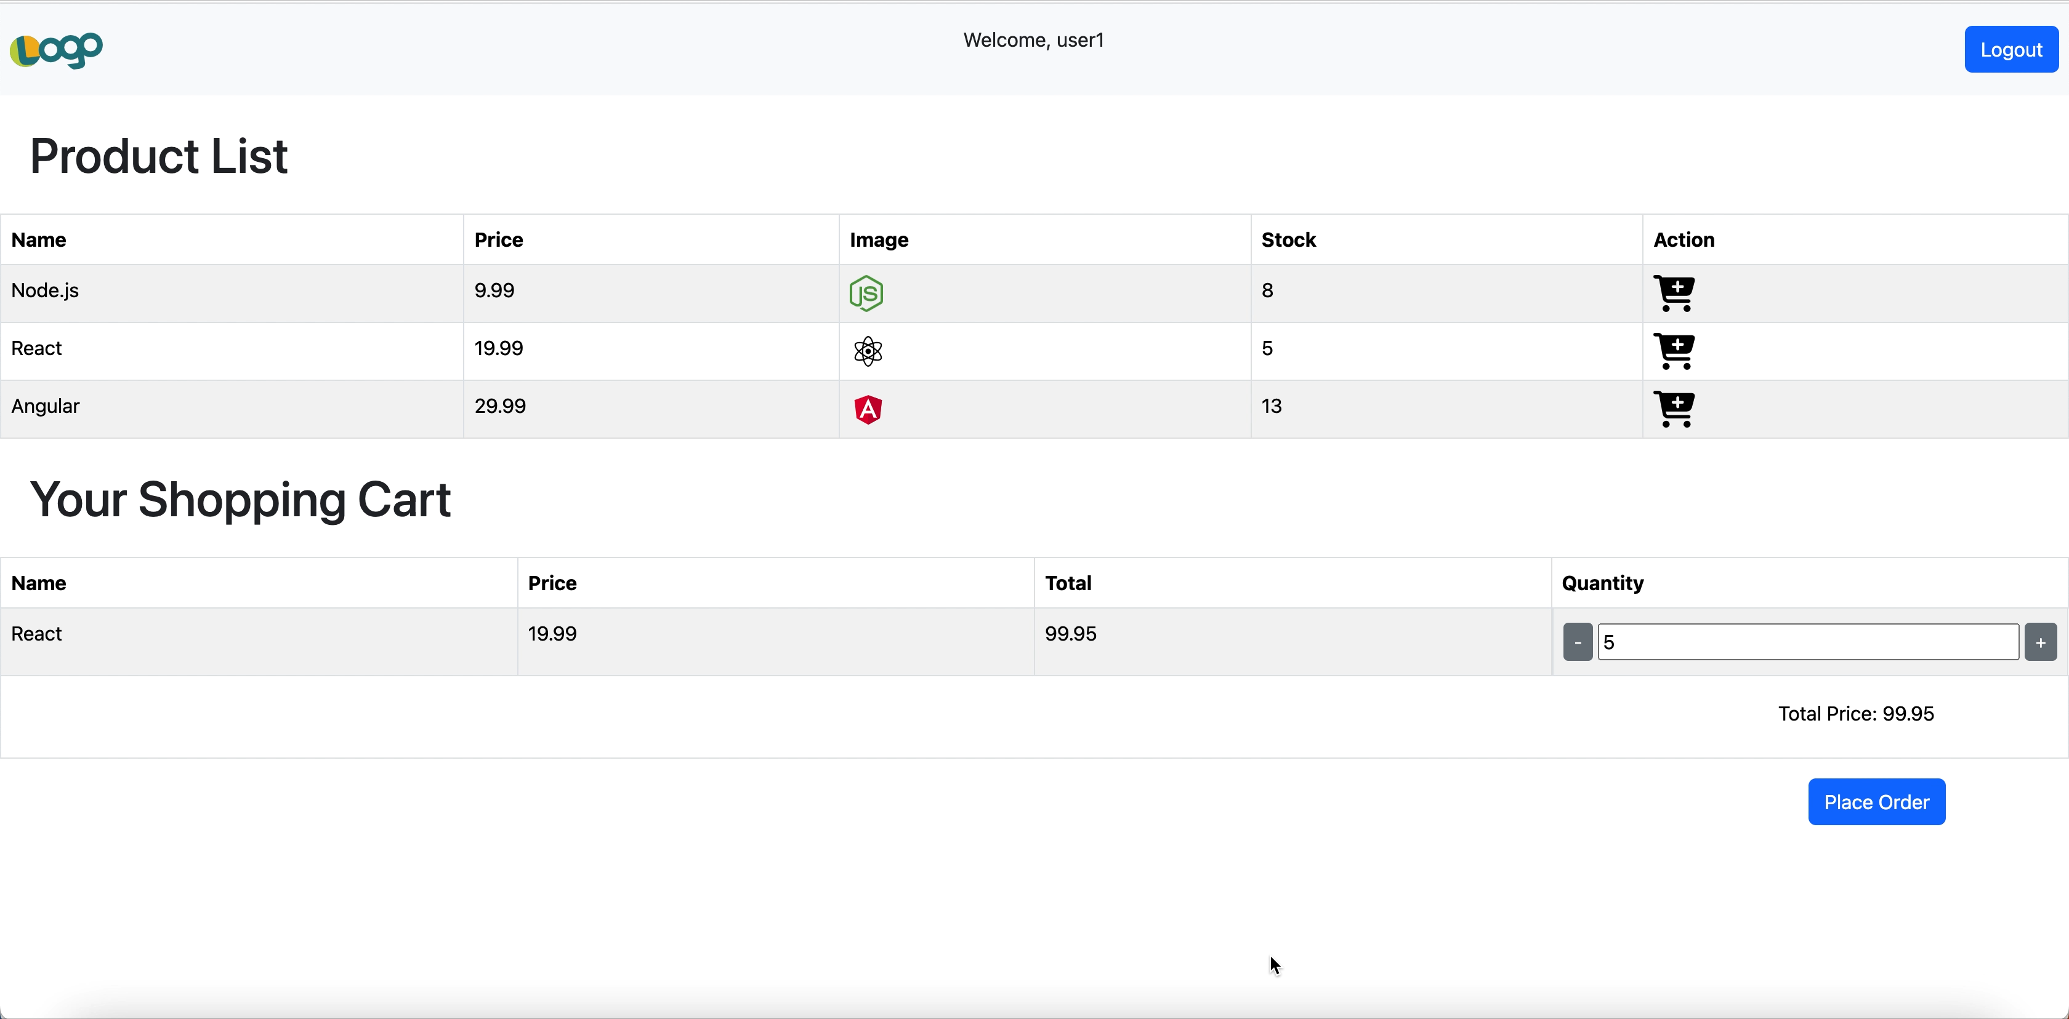
Place order

Slide 9

Thank you for watching

